Slide 1

Examination of the relevance of Hansen Solubility Parameters to prediction of environmental hazards
n Author: P.R. Fisk, M.J. Crookes and B.L. Barnes, Peter Fisk Associates n Date: 6th April 2017
n Email: peter.fisk@pfagroup.eu

Slide 2
Introduction
There are four points to emphasise in this lecture:
The regulatory and commercial significance of hazards of substances such as bioaccumulation and toxicity to aquatic organisms to the environment, as a general introduction for this session;
An investigation of whether HSP relate to these hazards;
Consideration of how desired solvency properties and hazard properties can be considered simultaneously;
Possible future developments.

Slide 3
Significance of this work 1
Hazards of substances to organisms in the environment relate strongly to their uptake from their immediate surroundings, and from water, sediment, or soil in particular.
These can have a controlling influence on the risk management of substances, particularly for non-degradable substances.
Therefore, selection and development of solvent systems needs to take hazard to the environment and mammals into account.

Slide 4
Significance of this work 2
Complex molecular behaviour is often described in terms of a single number (such as K_{ow} (= Pow), the octanol-water partition coefficient), using quantitative structure-activity relationships (QSAR).
Very different substances in physicochemical terms may share the same value of K_{ow} (= Pow), for example due to differing solubilities.
HSP may offer a more insightful approach, particularly for properties related to affinity of a molecule with a matrix;
These are related to processes such as solubility, transfer into and across cell walls and membranes, solubility in fat, adsorption to surfaces such as that of soil, and related underlying science.
Whereas parameters such as K_{ow} are only a surrogate for other phenomena, HSP provide an indication of affinity parameters.

Slide 5
Significance of this work 3
This is an initial survey to investigate whether the Hansen parameters are useful for description of bioconcentration in fish, and toxicity of substances in simple screening tests for fish, Daphnia and algae.
Toxicity to fish, Daphnia and algae may also be considered initially as a process of the body burden inducing adverse effects.
The present work explores the predictability of these properties and discusses the successes and limitations identified.

Slide 6
Significance of this work 4
Why could this work be of interest?
One particular benefit of the use of HSP is the possibility to examine the property space in respect of desirable solvation properties and undesirable hazards simultaneously.
Are there no-go areas for choice of solvent?
  This is particularly important when considering how to replace an unacceptable substance.

Slide 7
Regulatory context

Slide 8
‘PBT’ criteria 1
These are the ‘worst’ substances: which are persistent, bioaccumulative and toxic (PBT) or very persistent and very bioaccumulative (vPvB).
Identified according to set criteria under the EU REACH Regulation (Regulation (EC) No 1907/2006). See the Peter Fisk Associates book on REACH published by Wiley.
PBT and vPvB substances, along with substances termed ‘CMR’, are considered as substances of very high concern (SVHC) under the REACH Regulation.
One of the aims of the REACH Regulation is that SVHCs are progressively replaced by suitable alternative substances or technologies where these are economically and technically viable.

Slide 9
‘PBT’ criteria 2
Property | Criteria | Values
P (Persistent) | Biodegradation half-life | >40 days (freshwater or estuarine water) or >60 days (marine water) or >120 days (soil, or fresh or estuarine water sediment) or >180 days (marine sediment)
B (Bioaccumulative) | Bioconcentration factor (BCF) in aquatic species | BCF >2000 L/kg
T (Toxicity) | Long term no-observed effect concentration (NOEC) or EC₁₀ in aquatic organisms, or human health classification | NOEC <0.01 mg/L or Carcinogenic category 1A or 1B or Germ cell mutagenic category 1A or 1B or Toxic for reproduction category 1A, 1B or 2 or Evidence of chronic toxicity (STOT RE category 1 or 2).
vP (very Persistent) | Biodegradation half-life | >60 days (freshwater, estuarine water or marine water) or >180 days (soil, or fresh, estuarine or marine water sediment)
vB (very Bioaccumulative) | Bioconcentration factor (BCF) in aquatic species | BCF >5000 L/kg

Slide 10
Impact of being assessed as meeting ‘PBT’
According to REACH Article 57(d), PBT and vPvB chemicals can be included in the Authorisation List of Annex XIV.
The use and placing on the market of these Annex XIV substances is not allowed from a specified date, unless the European Commission has granted an authorisation for that specific use.
Within the context of REACH, it is not possible to establish a “safe” threshold level for PBT/vPvB chemicals.
Additional risk management measures to reduce emissions to the lowest possible levels is required.

Slide 11
What about other cases?
Even for substances that are not ‘PBT’, substances that are very toxic are likely to have an adverse environmental risk assessment.
Control of exposure is often necessary to demonstrate safe use.

Slide 12
How might HSP relate to PBT or toxicity properties?
This question is explored in the case studies, but a quick review of HSP and the classical pollutants is instructive.
The following table lists example substances from the HSP database which have δD greater than 20 and an average of δP and δH less than 7 (which is the sort order).
Classic persistent organic pollutants have been highlighted.
It is striking that very few such substances can be found outside this table.
Persistent organic pollutants (POPs) identified under the Stockholm Convention.
Other substances with PBT or vPvB properties.
Not PBT or vPvB.

Slide 13
Name | δD | δP | δH
Hexachlorobenzene | 20.3 | 2.1 | 0
Fluorene | 21.3 | 1.7 | 1.7
Ddt P,P' -Ddt O,P' -Ddt O,P' -Ddt | 20.6 | 2.3 | 1.6
1,2,3,4,5,6,7,8-Octachlorodibenzofuran | 22 | 2.4 | 1.9
Benzo(K)Fluoranthene | 20.6 | 0 | 4.6
Octachlorostyrene | 21 | 3.6 | 1.1
Hexachlorobiphenyl | 21.4 | 2.9 | 1.9
1,2,3,4,7,8-Hexachlorodibenzofuran | 21.6 | 3 | 2.4
2,2',3,4,5,5',6'-Heptachloro-1,1'-Biphenyl | 21.8 | 3.4 | 2.1
1,2,3,4,6,7-Hexachlorodibenzofuran | 21.6 | 3.1 | 2.4
Biphenylene | 20.5 | 2.9 | 3
Anthracene | 20.5 | 1.5 | 4.8
2,3',4,4',5-Pentachlorobiphenyl | 21.3 | 4.1 | 2.6
1,2,3,6,7,8-Hexachlorodibenzofuran | 22.7 | 4.7 | 2.1
2,3-Dichloro-1,1'-Biphenyl | 20.2 | 3.6 | 3.2
1,4-Dichloronaphthalene | 20.2 | 2.5 | 4.4

Slide 14
Name | δD | δP | δH
1,8-Dichloronaphthalene | 20.2 | 2.5 | 4.4
2,2',5-Trichloro-1,1'-Biphenyl | 20.7 | 4.2 | 2.8
2,2',6-Trichlorobiphenyl | 20.7 | 4.2 | 2.8
2,2',4-Trichlorobiphenyl/Pcb | 20.7 | 4.2 | 2.8
P,P' -Ddd | 20.6 | 4.1 | 2.9
Diphenyl Sulfide | 20.6 | 3.7 | 3.3
Pentachlorobenzene | 20.8 | 5 | 2.6
2,2',3,4,4',5,5'-Heptachlorodiphenylether | 22.4 | 5.2 | 2.9
Dibenzothiophene | 20.6 | 3.7 | 4.4
Tridiphane | 20.1 | 4.7 | 3.5
Naphthalene, 2-Chloro- | 20 | 3.9 | 4.4
1,2,3,4-Tetrachlorodibenzo-p-Dioxin | 21.3 | 4 | 4.4
9-N Butylphenanthrene | 20.1 | 3.9 | 4.5
Carbon Tetraiodide | 22.6 | 5.4 | 3.1
1,2,3,4-Tetrachloronaphthalene | 20.4 | 4.5 | 4
DDT | 20 | 5.5 | 3.1

Slide 15
Name | δD | δP | δH
2,2',3,4,4',6-Hexachlorodiphenylether | 22.2 | 5.7 | 3.3
Diphenylamine | 20 | 3.3 | 5.9
1,2,3,7,8,9-Hexachlorodibenzo-p-Dioxin | 23 | 5.6 | 3.8
a-Endosulfan | 20.2 | 7.6 | 2.1
Endosulfan | 20.2 | 7.6 | 2.1
Benzo[H]Quinoline | 20.6 | 4.9 | 5.3
Benzyl Benzoate | 20 | 5.1 | 5.2
2-Aminobiphenyl | 20 | 4 | 7.1
Anthone | 20.6 | 7.3 | 3.9
1-Benzo[B]Thien-2-Ylethan-1-One | 20.2 | 6.1 | 5.1
Quinoline | 20.5 | 5.6 | 5.7
2-Aminoanthracene | 20.8 | 2.8 | 8.5
Hexabromobenzene | 21.9 | 7.5 | 5.1
Benzene, 1,3-Dichloro-2-Nitro- | 20 | 8.8 | 4.7
2,2',4,4',5,6'-Hexabromodiphenyl Ether (Bde 154) | 22.2 | 8.1 | 5.4

Slide 16
Four case studies
Given the high level of regulatory concern over substances with PBT and vPvB properties, and toxicity, it is important that methods are available to help identify substances that may potentially have these properties in the early stages of solvent or process development.
To this end, a preliminary investigation has been undertaken into the possible relationship between certain basic solvent properties, as described by the Hansen Solubility Parameters, and environmentally-relevant properties.
  Octanol-water partition coefficient – simply because it has been used so widely before.
  Bioaccumulation potential.
  Ecotoxicity.
.

Slide 17
Octanol-water partition coefficient of alcohols
Name | δD | δP | δH | Log K_{ow}
Methanol | 14.7 | 12.3 | 22.3 | -0.77
Ethanol | 15.8 | 8.8 | 19.4 | -0.31
1-Butanol | 16 | 5.7 | 15.8 | 0.88
1-Pentanol | 15.9 | 5.9 | 13.9 | 1.51
1-Hexanol | 15.9 | 5.8 | 12.5 | 2.03
1-Heptanol | 16 | 5.3 | 11.7 | 2.62
1-Octanol | 16 | 5 | 11.2 | 3
1-Nonanol | 16 | 4.8 | 11 | 3.77
1-Decanol | 16 | 4.7 | 10.5 | 4.57
1-Undecanol | 16 | 4.1 | 9.2 | 4.43
Dodecanol | 16 | 4 | 9.3 | 5.13
1-Tetradecanol | 16 | 3.3 | 8.3 | 5.84
1-Pentadecanol | 16 | 3.4 | 7.8 | 6.38
1-Hexadecanol | 16.4 | 3.7 | 8.1 | 6.73
1-Octadecanol | 16 | 2.8 | 7.4 | 7.73

Slide 18
Aquatic effects are severe

Slide 19
2 Chlorinated hydrocarbons
A set of 93 non-aromatic chlorinated alkanes and alkenes has been studied.
Those with carbon chains longer than 6 were excluded. The substances, sorted by δP, are listed in the handout. It is interesting how little variability in δD is seen.
There is a relationship between log K_{ow} and HSP, but the statistical form needs more work.

Slide 20
3. Substitution of trichloroethylene
Consider that trichloroethylene, a carcinogen, needs to be replaced by a single chemically-related substance. The candidates with closest δP and δH are listed below, with comments; compromise?
Name | δD | δP | δH | Log K_{ow} | Comment
Chloroform | 17.8 | 3.1 | 5.7 | 1.97 | Volatile, very soluble in water, toxic
Trichloroethylene | 18 | 3.1 | 5.3 | 2.42 | Carcinogen; Likely to not biodegrade
2-Chlorohexane | 15.9 | 3.1 | 2.4 | 3.58 | Likely to (bio)degrade
Trans-1-Chloro-1-Propene | 16.3 | 4.3 | 4 | 2.01 | Likely to (bio)degrade; volatile
Cis-1-Chloro-1-Propene | 16.3 | 4.3 | 4 | 2.01 | Likely to (bio)degrade, volatile
1,1,1,2-Tetrachloroethane | 18 | 4.4 | 4.2 | 2.66 | Does not degrade
1,1,2,2-Tetrachloroethane | 18.8 | 5.1 | 5.3 | 2.39 | Does not degrade
1-Bromopropane | 16.4 | 7.9 | 4.8 | 2.10 | SVHC; Toxic for reproduction

Slide 21
4. Bioconcentration factor
Bioconcentration in fish represents a case where relative solubility and membrane transfer need to be understood. The database of fish BCF values from the BCFBAF v3.01 model¹ was compared with the Hansen Solubility Parameters database.
This gave 515 BCF values for substances for which Hansen Solubility Parameters were available. These are listed in the handout.
A reasonable regression relationship between log BCF and HSP was found; however, it is more instructive to view the pattern.
The bands in the chart following refer to classification boundaries. High BCF is also associated with persistence for the most part.
¹ BCFBAF v3.01. US EPA., 2012. Estimation Programs Interface Suite™ for Microsoft® Windows, v 4.11. United States Environmental Protection Agency, Washington, DC, USA.

Slide 22
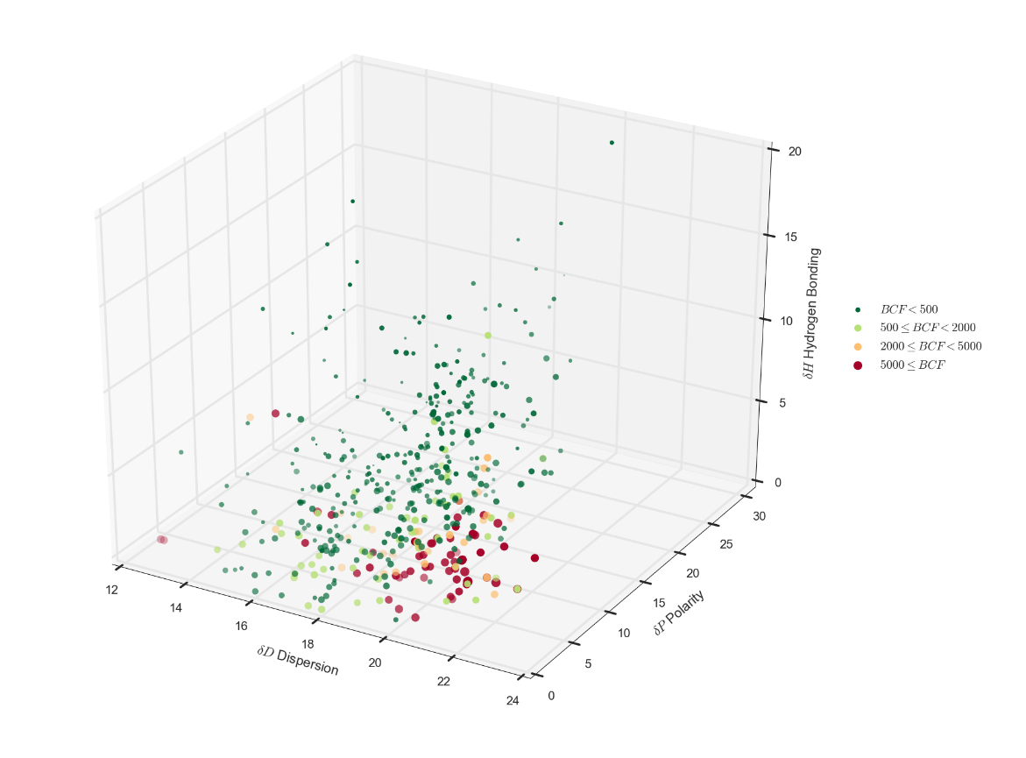

Slide 23
Ecotoxicity in general
Correlations of the Hansen Solubility Parameters with acute toxicity data (LC₅₀ or EC₅₀) for fish, Daphnia magna and algae have also been investigated, across many chemical classes.
The ecotoxicity data sets used were those used to develop the ECOSAR v1.11 estimation program².
Again, linear correlations of log10 LC₅₀ or EC₅₀ (in mmole/L) with the δD, δP and δH in turn suggested a general trend.
The LC₅₀ or EC₅₀ decreased as the value of δD increased
The LC₅₀ or EC₅₀ increased as the δP or δH increased.
² ECOSAR v1.11. US EPA., 2012. Estimation Programs Interface Suite™ for Microsoft® Windows, v 4.11. United States Environmental Protection Agency, Washington, DC, USA.

Slide 24
For acute toxicity to Daphnia magna:
Regression Statistics
Multiple R | 0.812
R Square | 0.659
Adjusted R Square | 0.644
Standard Error | 0.952
Observations | 72
 | Coefficients | Standard Error | t Stat | P-value | Lower 95% | Upper 95%
Intercept | 9.895 | 1.594 | 6.207 | 3.67E-08 | 6.714767 | 13.07634
δD | -0.616 | 0.0821 | -7.505 | 1.73E-10 | -0.78077 | -0.4528
δP | 0.040 | 0.0318 | 1.256 | 0.213112 | -0.02351 | 0.10352
δH | 0.053 | 0.0264 | 2.037 | 0.045519 | 0.001103 | 0.106463
Not a great regression but shows potential, even compared to other methods

Slide 25
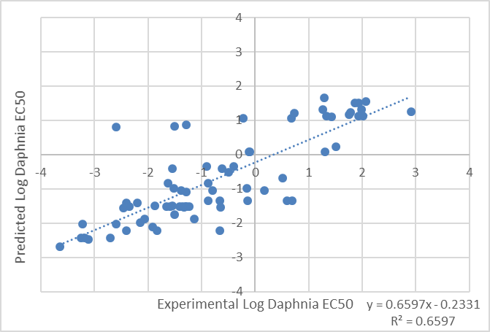

Slide 26
Summary and conclusions
Conclusions:
Regulatory pressures are critical in respect of commercial viability
HSP do relate to hazardous properties for the environment, such as bioaccumulation potential and ecotoxicity.
The use of HSP allows the property space in respect of desirable solvation properties and undesirable hazards simultaneously.
Future possibilities:
Investigate level of interest;
Apply same principles to discovery of new substances as solvents;
Examine ways to express the relationships quantitatively.

Slide 27
Thank you
n Author: P.R. Fisk, M.J. Crookes and B.L. Barnes, Peter Fisk Associates n Date: 6th April 2017
n Email: peter.fisk@pfagroup.eu

